Slide 1
Navigating the future of Online Shopping

Slide 2
Company Background
E-commerce Retailer operating across Brazil with diverse product categories.
Platform connects customers, sellers, and logistics providers.
Large dataset containing orders, customers payments, products, and sellers.
Business challenge: extract actionable insights from data to improve growth, retention, and revenue.

Slide 3
What This Analysis Will Do
Provide 15 key insights into customer behavior, sales trends, and revenue drivers.
Use data analysis & visualization to answer important business questions like:
Which cities/states have the most customers?
How do sales differ across product categories?
What is the YoY growth & retention rate?
Who are the top customers contributing to revenue?
Deliver clear visualizations and recommendations to support data-driven decision making.

Slide 4
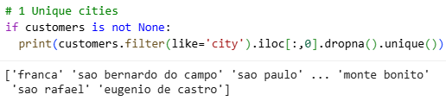

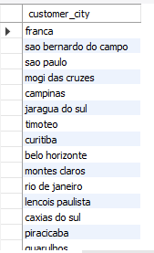
BASIC PROBLEMS
1. List all unique cities where customers are located.
Python Code
SQL Code

Slide 5
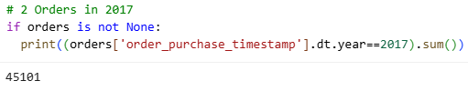


BASIC PROBLEMS
2. Count the number of orders placed in 2017.
Python Code
SQL Code

Slide 6
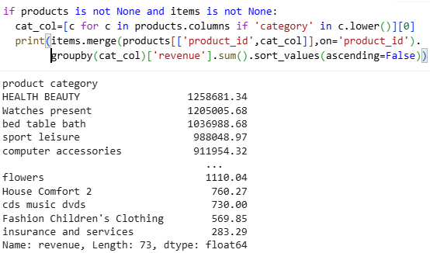
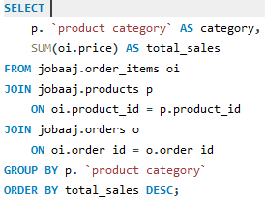
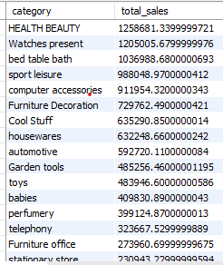
BASIC PROBLEMS
3. Find the total sales per category.
Python Code
SQL Code

Slide 7
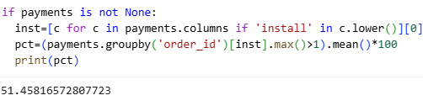
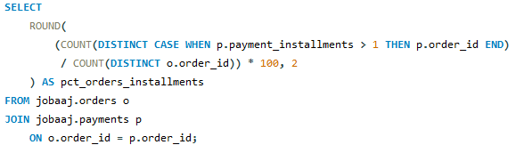

BASIC PROBLEMS
4. Calculate the percentage of orders that were paid in installments.
Python Code
SQL Code

Slide 8
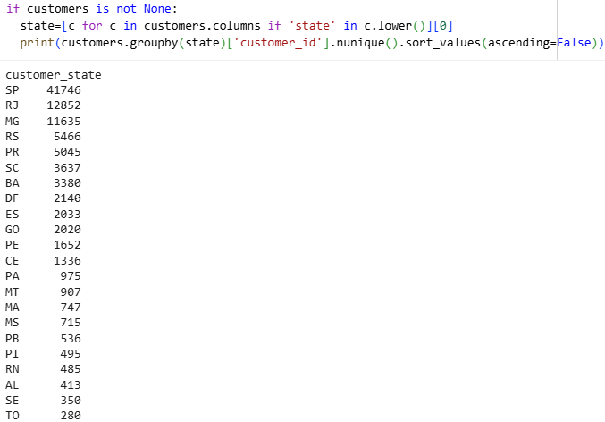
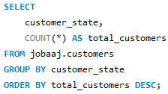
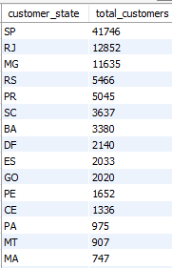
BASIC PROBLEMS
5. Count the number of customers from each state.
Python Code
SQL Code

Slide 9
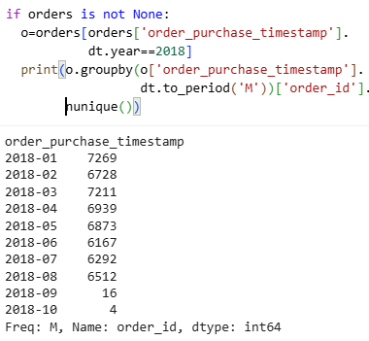
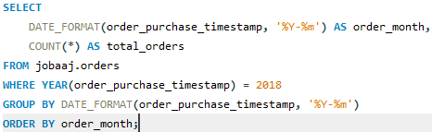
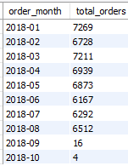
INTERMEDIATE PROBLEMS
1. Calculate the number of orders per month in 2018.
Python Code
SQL Code

Slide 10
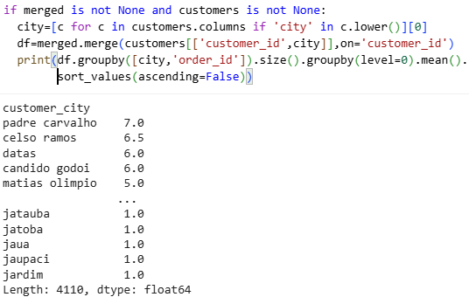
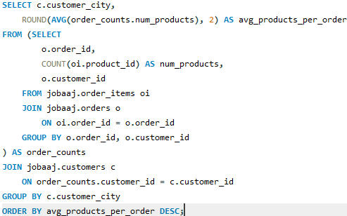
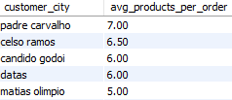
INTERMEDIATE PROBLEMS
2. Find the average number of products per order, grouped by customer city.
Python Code
SQL Code

Slide 11
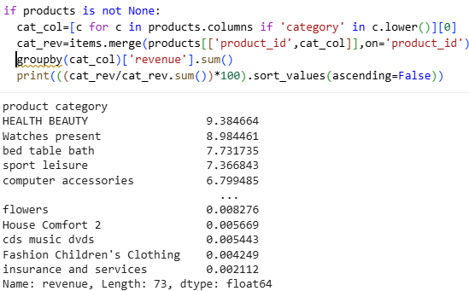
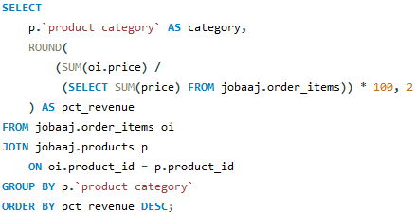
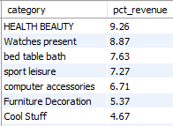
INTERMEDIATE PROBLEMS
3. Calculate the percentage of total revenue contributed by each product category
Python Code
SQL Code

Slide 12
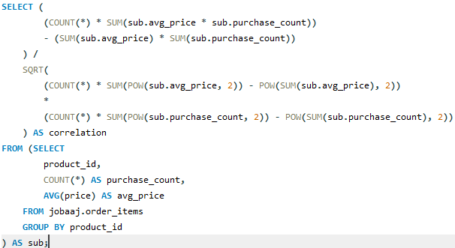
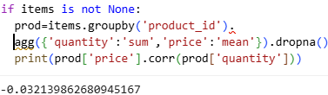

INTERMEDIATE PROBLEMS
4. Identify the correlation between product price and the number of times a product has been purchased.
Python Code
SQL Code

Slide 13
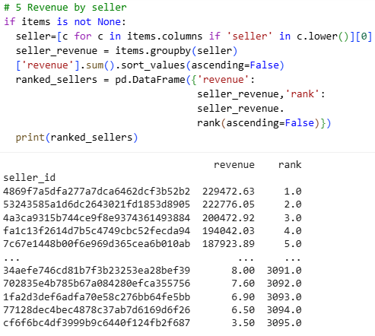
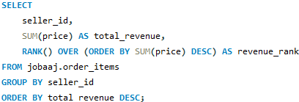
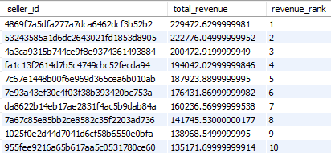
INTERMEDIATE PROBLEMS
5. Calculate the total revenue generated by each seller, and rank them by revenue.
Python Code
SQL Code

Slide 14
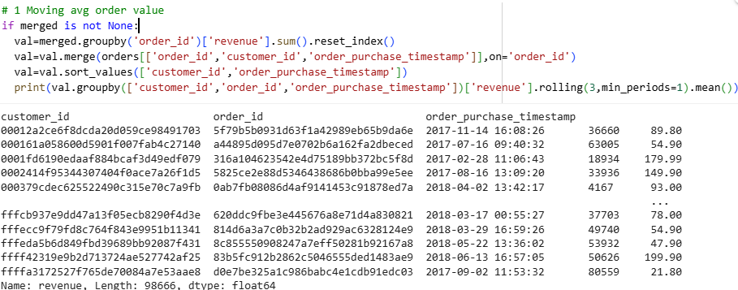
ADVANCED PROBLEMS
1. Calculate the moving average of order values for each customer over their order history.
Python Code

Slide 15
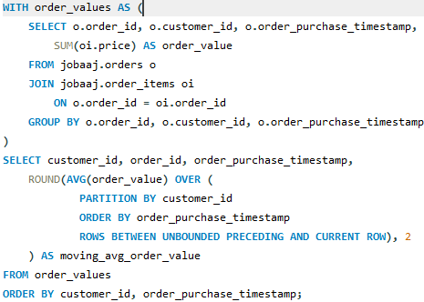
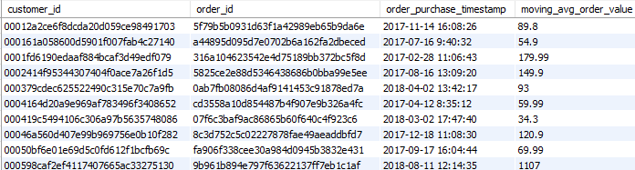
ADVANCED PROBLEMS
1. Calculate the moving average of order values for each customer over their order history.
SQL Code

Slide 16
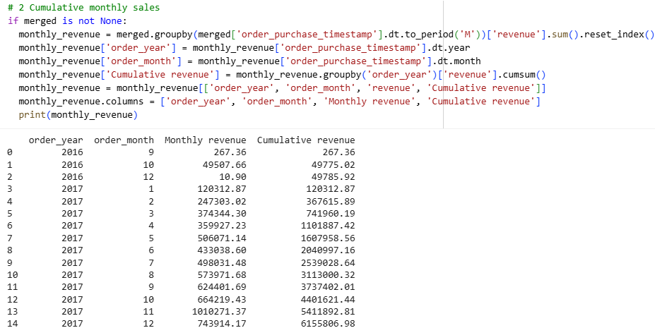
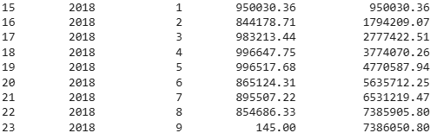
ADVANCED PROBLEMS
2. Calculate the cumulative sales per month for each year.
Python Code

Slide 17
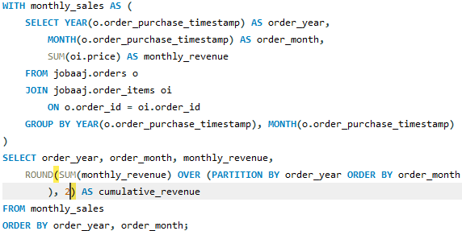
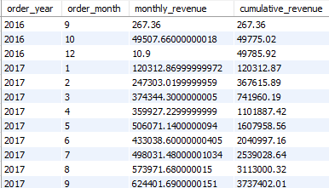
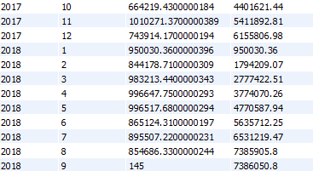
ADVANCED PROBLEMS
2. Calculate the cumulative sales per month for each year.
SQL Code

Slide 18
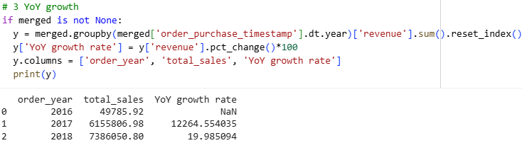
ADVANCED PROBLEMS
3. Calculate the year-over-year growth rate of total sales.
Python Code

Slide 19
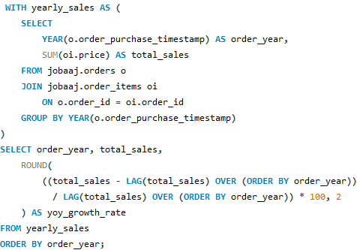

ADVANCED PROBLEMS
3. Calculate the year-over-year growth rate of total sales.
SQL Code

Slide 20
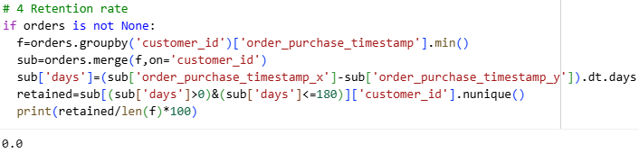
ADVANCED PROBLEMS
4. Calculate the retention rate of customers, defined as the percentage of customers who make another purchase within 6 months of their first purchase.
Python Code

Slide 21
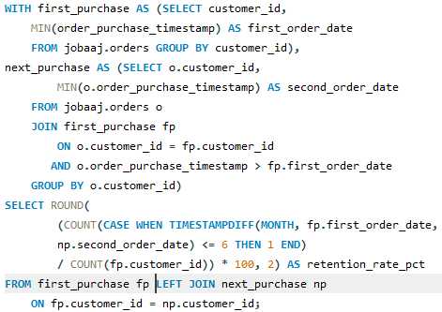

ADVANCED PROBLEMS
4. Calculate the retention rate of customers, defined as the percentage of customers who make another purchase within 6 months of their first purchase.
SQL Code

Slide 22
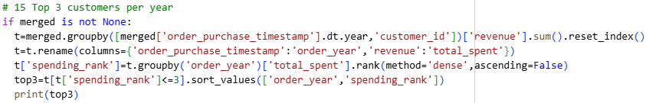
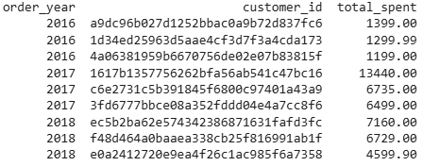
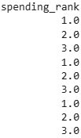
ADVANCED PROBLEMS
5. Identify the top 3 customers who spent the most money in each year.
Python Code

Slide 23
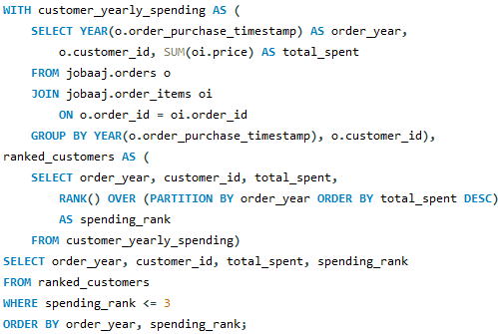
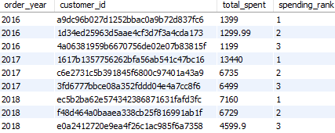
ADVANCED PROBLEMS
5. Identify the top 3 customers who spent the most money in each year.
SQL Code

Slide 24
CONCLUSION
Strong sales in certain cities/states → potential to scale logistics & marketing there.
Category analysis shows top revenue drivers but also highlights underperforming categories.
Installment payments play a role in purchase decisions → financial flexibility matters.
Customer retention rate is low → high focus on repeat sales strategy is needed.
A few top customers contribute disproportionately to revenue.

Slide 25
RECOMMENDATIONS
Expand in High-Demand Regions → prioritize cities/states with most unique customers.
Category-Specific Marketing → promote bestsellers, discount underperforming categories.
Retention Programs → loyalty rewards, personalized offers to boost repeat orders.
Financial Options → enhance installment/EMI schemes to drive conversions.
High-Value Customer Strategy → exclusive deals & premium support for top spenders.

